Slide 1
Code & Language translator
Presented By S.R.Zameer

Slide 2
Source Code
Source code is in the form of Text form.
Source code is Human Readable Code.
Source code is Generated by Human or Programmer.
Source code is receive Compiler as a Input.

Slide 3
Object Code
Object Code is in the form of Binary Numbers.
Object Code is in Machine Readable formats.
Object Code is Generated by Compiler.
Object Code is Generated by Compiler as a Output.

Slide 4
Language Translator
Assembler
Compiler
Interpreter

Slide 5
Assembler
An assembler is system software which is used to convert the assembly language instruction into binary format in step by step process. An assembler is system software which is used to convert the assembly language instruction into binary format.

Slide 6
Compiler
A compiler is system software which converts programming language code into binary format in single steps. In other words Compiler is a system software which can take input from other any programming language and convert it into lower level machine dependent language.

Slide 7
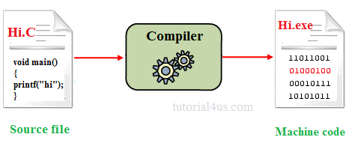

Slide 8
Interpreter
It is system software which is used to convert programming language code into binary format in step by step process.

